Slide 1
Fundamentals of Information Technology
S.S.NACHIYA
DEPT., OF C.S.,

Slide 2
Communication Software
Communication software is used to provide remote access to systems and exchange files and messages in text, audio and/or video formats between different computers or users.
This includes terminal emulators, file transfer programs, chat and instant messaging programs.
Here are the top 10 communication software features for small businesses.
1. Direct and group messaging
2. Video chat
3. Screen sharing
4. Audio conferencing
5. Secured file sharing
6. Deep app integrations
7. Shared note taking
8. Search and bookmarking
9. Company directories
10. Team mailing lists

Slide 3
1. Direct and group messaging
Easily the most important feature every small business communication tool should have is messaging. Direct messaging or instant messaging lets you communicate one-on-one with your teammates. Group messaging expands on that feature by connecting you to the entire team.
The ability to communicate with your team in real-time from your computer or smartphone is critical, and small businesses need more than just email alone. With Flock, you can begin a chat with anyone on your team by simply creating a channel. Use a private channel for focused discussions, or a public one to let your teammates easily discover and join meaningful conversations.

Slide 4
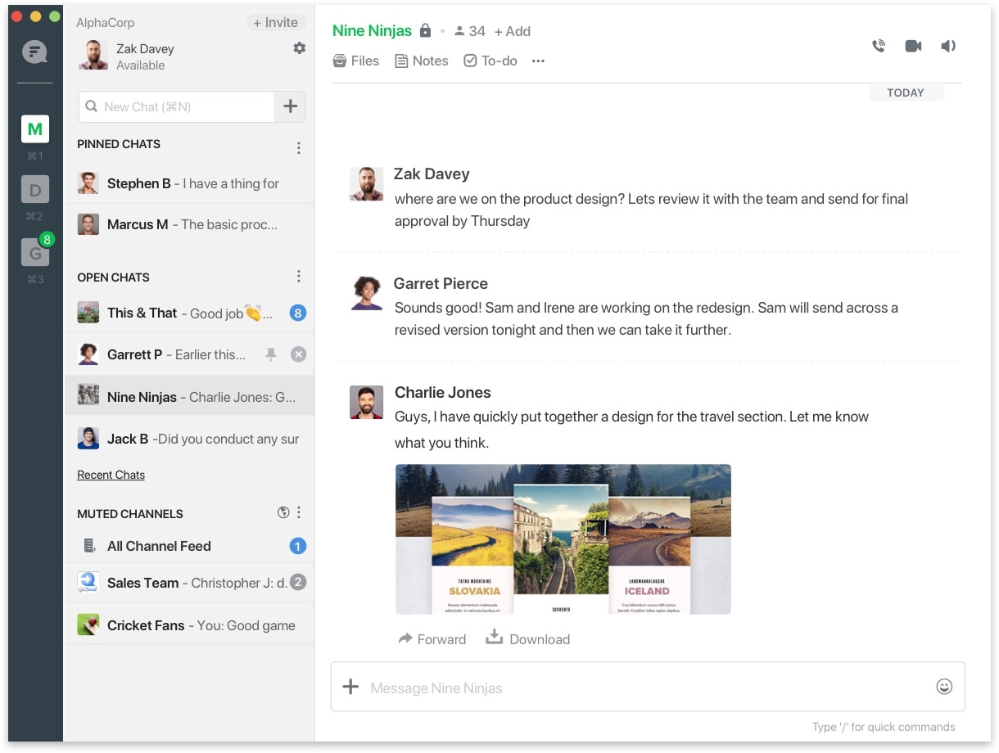

Slide 5
2. Video chat
we can take direct messaging to the next level when you have direct messaging also means having the ability to connect with your remote team over video from anywhere. Not having a straightforward video chat solution will turn out to be a nightmare if you need to have a face-to-face with a direct report or a more meaningful group conversation.
The best video conference features will let you initiate a video call with one click, but the right communication software will allow you to start the video call from within an existing chat. If the communication tool you’re using doesn’t let you start a video chat with one click directly in an existing conversation, then there’s likely a better option out there.

Slide 6


Slide 7
3. Screen-sharing
The other benefit of having a reliable video chat feature is screen-sharing. The ability to share your screen directly in a conversation (even from your smartphone) is an invaluable convenience when you need to pull up a report or review an important doc in the middle of a meeting. Not having to switch to another app or leave your existing video chat saves time, preserves momentum, and keeps everyone on the same screen, even on the go.

Slide 8
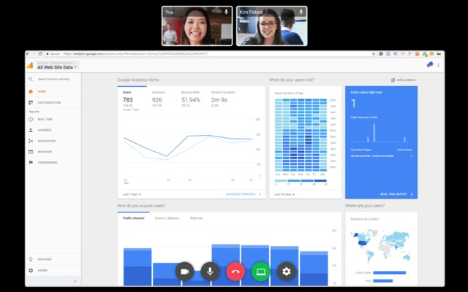

Slide 9
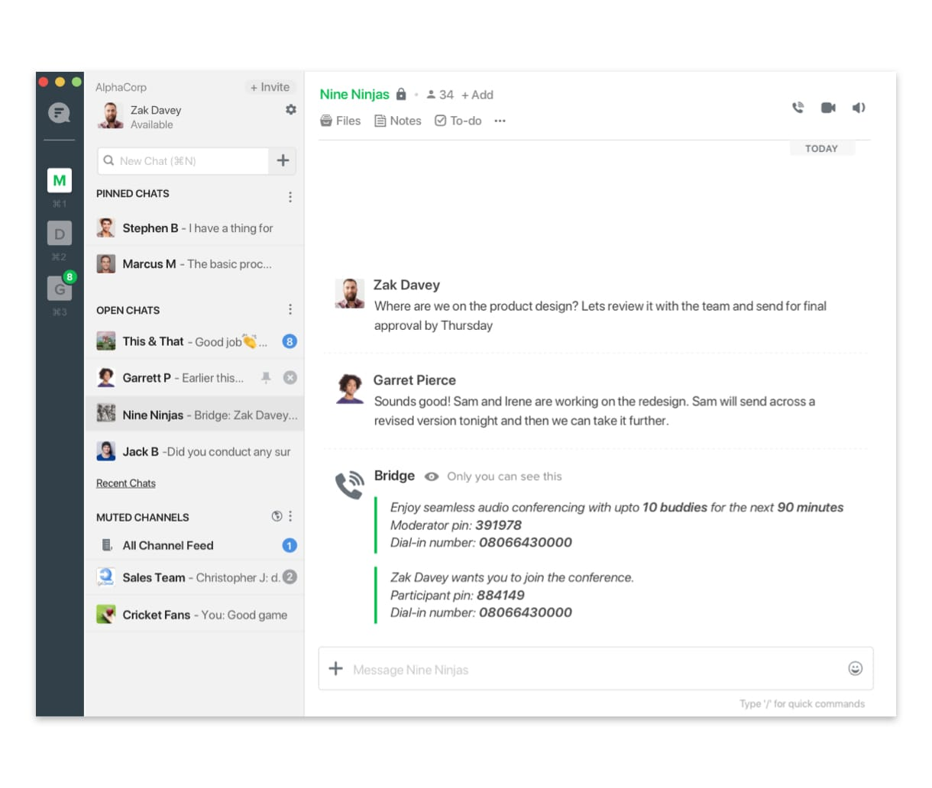
4. Audio conferencing
Direct voice and audio calling should come standard with any communication software tool on your radar. If you ever need to clarify a point on the spot or quickly follow-up on a conversation you’re having, inviting your team to an audio conference makes sense when jumping on video won’t work.
This simple feature is great for remote teams to be able to dial in directly from your desktop or mobile device without having to set up an external app or a separate line of communication.

Slide 10
5. Shared note taking
Scribbling down notes on paper is old-school, especially when your whole team can benefit from them. If you’ve ever had a great idea in the middle of a meeting, utilizing the shared note-taking feature built into communication tools encourages your teammates to share their own ideas. This ignites collaboration. The ability to make edits and track changes across the chats where you've shared notes is also a prime feature worth noting.
Launching a new product or testing a new piece of code? Share it with stakeholders or set tasks to an agenda directly in your messenger so that everyone is—literally—on the same page. Flock automatically detects code language and syntax, making it easier for teammates to read and review your notes and snippets.

Slide 11
